Slide 1
Univariate Analysis
By Raghav Tyagi

Slide 2
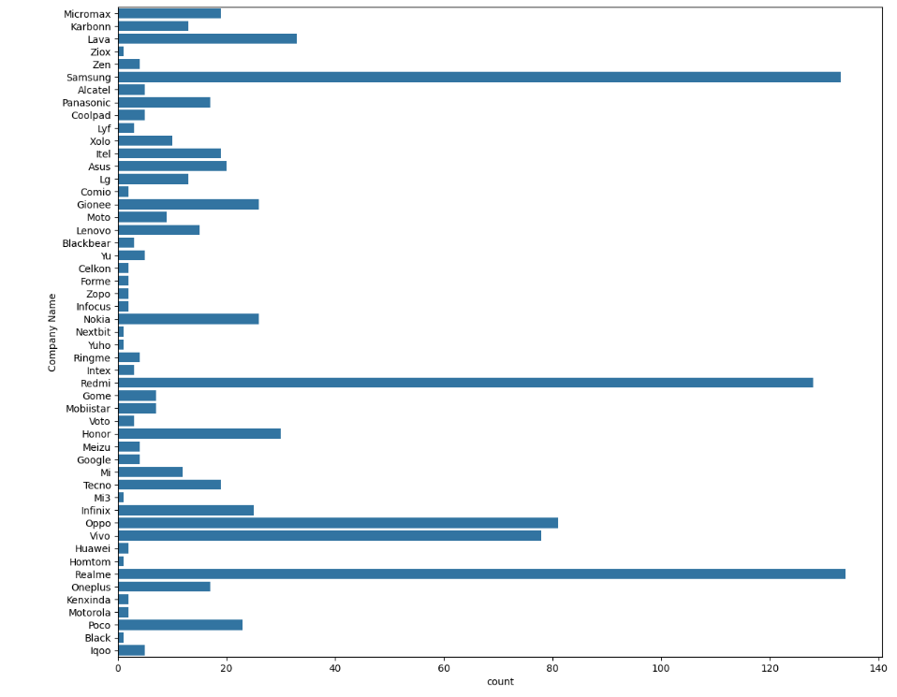
Univariate Analysis
Samsung, Redmi & Realme have been the most prominent brands among brands
Oppo & Vivo can also be seen as growing players in the Market

Slide 3
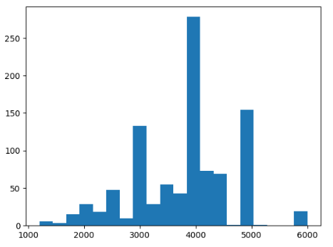
Battery Power
Smart Phones with Battery power 3000 to 5000 Mah are more popular among others and were seen as more popular among devices

Slide 4
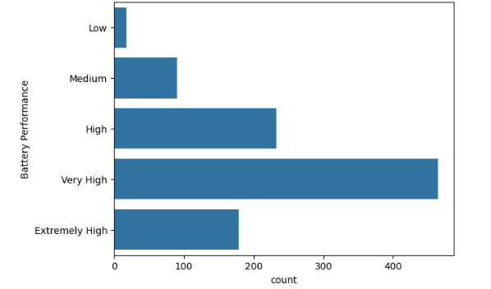
Battery Performance
High & Very High-Performance Batteries are more popular among devices.
The reason for Extremely High-Performance batteries not preferred Could be Risk and Hazard from Heating Devices

Slide 5
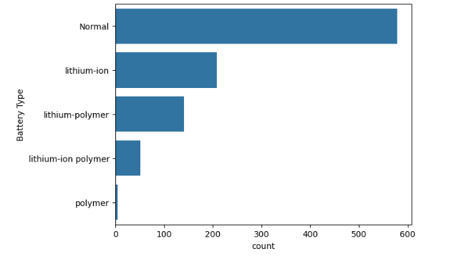
Battery Types
Normal Batteries are found in most of the devices.
Polymer batteries were found to be the least used in devices.

Slide 6
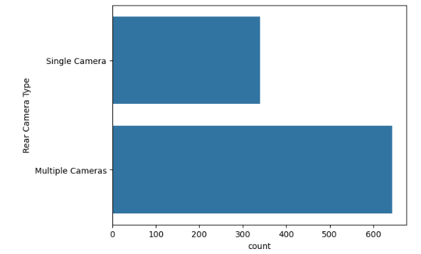
Rear Camera Type
Phones with Multiple Rear Type Cameras are found to be more popular for Capturing Images & Videos.

Slide 7
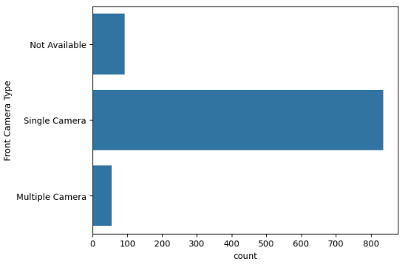
Front Camera Type
Most of the devices were found to be equipped with a single front camera.
And Multiple front cameras were found to be in very less number of devices

Slide 8
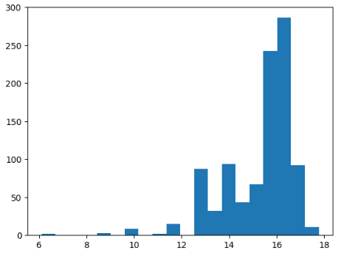
Display Size
Generally Devices with Display sizes around 15 to 16.5 inches were found to be more common in devices
Whereas large sizes and very low display sizes were uncommon.

Slide 9
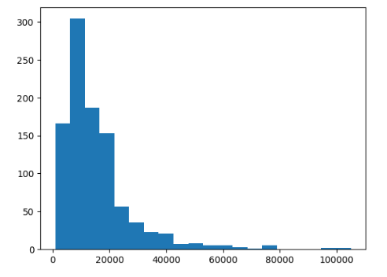
Prices
Generally phones priced between 5000 to 15000 were most common as they are affordable.

Slide 10
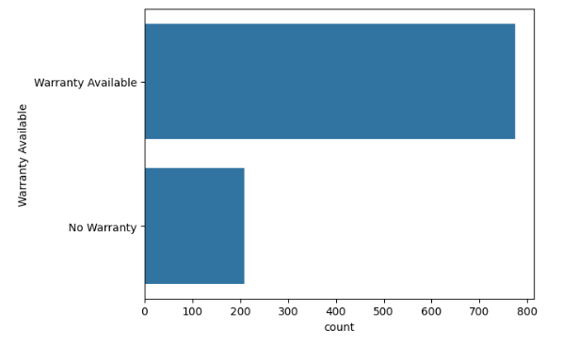
Warranty
Most of the devices had warranties available be it for an accessory or the whole device.

Slide 11
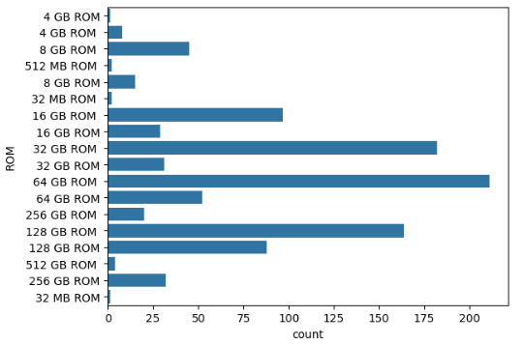
ROM
Smart Phones with ROM Around 64 GB were most commonly seen.
128 GB & 32 GB were also common among devices

Slide 12
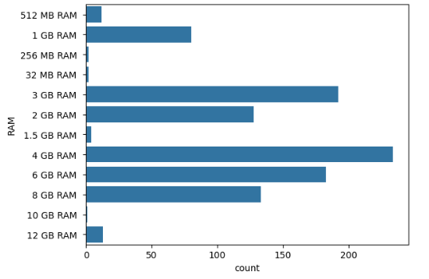
RAM Storage
RAM with 4GB was commonly seen in devices followed by 3GB & 6GB

Slide 13
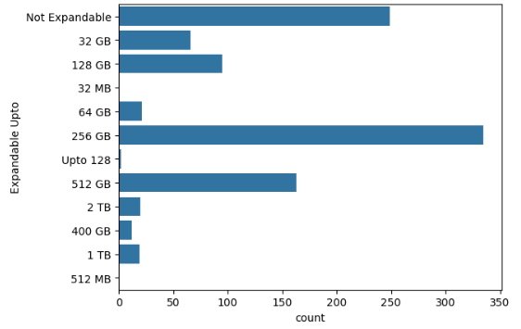
Expandable Memory
Devices with Expandable memory up to 256 GB were found to be more common among devices.
Where as good number of devices also had Un Expandable memory.

Slide 14
Bivariate Analysis
By Raghav Tyagi

Slide 15
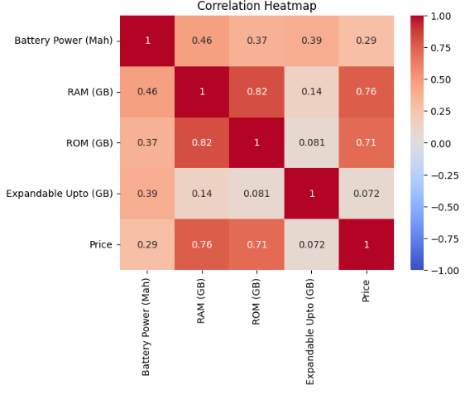
Prominent Factors Affecting the Prices
The most influential factors on device pricing are RAM and ROM. The strong correlations between these features and price suggest that higher RAM and ROM typically lead to higher prices. Battery power and expandable storage have less impact on the price and are less interrelated with other features.

Slide 16
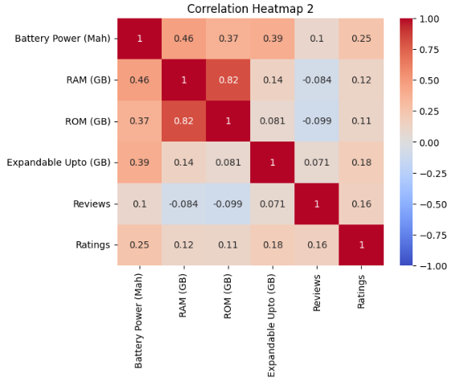
Prominent Factors Affecting the Ratings
Battery Power (mAh) has the most notable positive impact on ratings compared to other parameters, though the correlation is still moderate.
RAM (GB), ROM (GB), and Expandable Upto (GB) have weak positive correlations with ratings, indicating their influence is less significant.
Reviews also show a weak positive correlation with ratings, suggesting that more reviews can lead to better ratings, though the relationship is not strong.
Battery Power seems to have the most significant impact on ratings among the parameters analyzed, but the correlations are relatively low, indicating that many other factors likely influence ratings.

Slide 17
Other Insights
By Raghav Tyagi

Slide 18
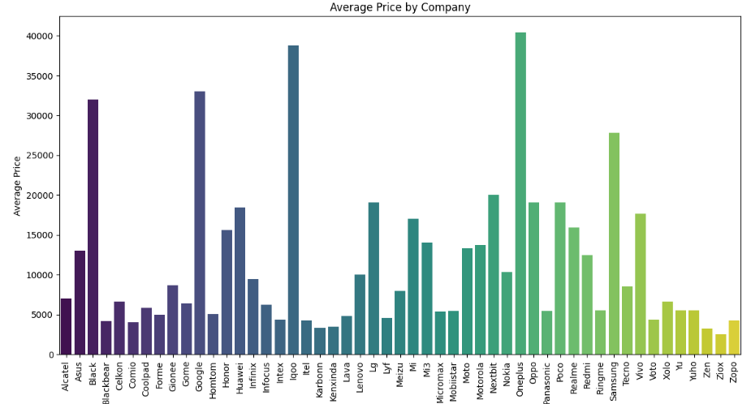
Average Price Company Wise
Oneplus, Iqoo, Black, Google & Samsung have high average smartphone prices.
Whereas companies like Huawei, Lenovo, Gionee, N0kia, Mi, and Redmi have average prices around between 15000 to 10000.
Companies like Zopo, Ziox, Zen, and Blackbear have average prices under 5000.

Slide 19
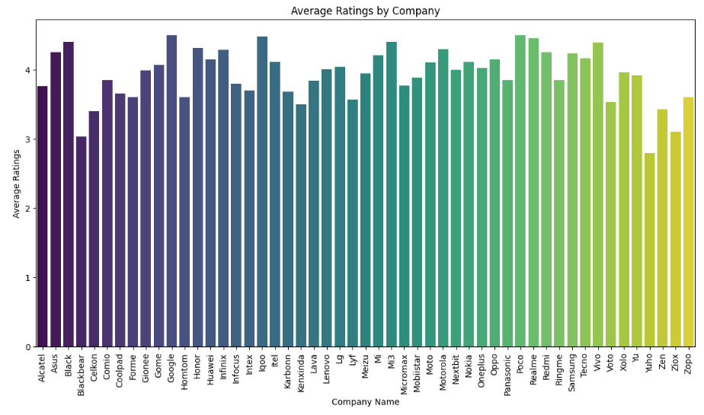
Average Rating Company Wise
Almost every Company has an average rating of around 3 to 4.
While certain companies have been found to have average ratings below 3.

Slide 20
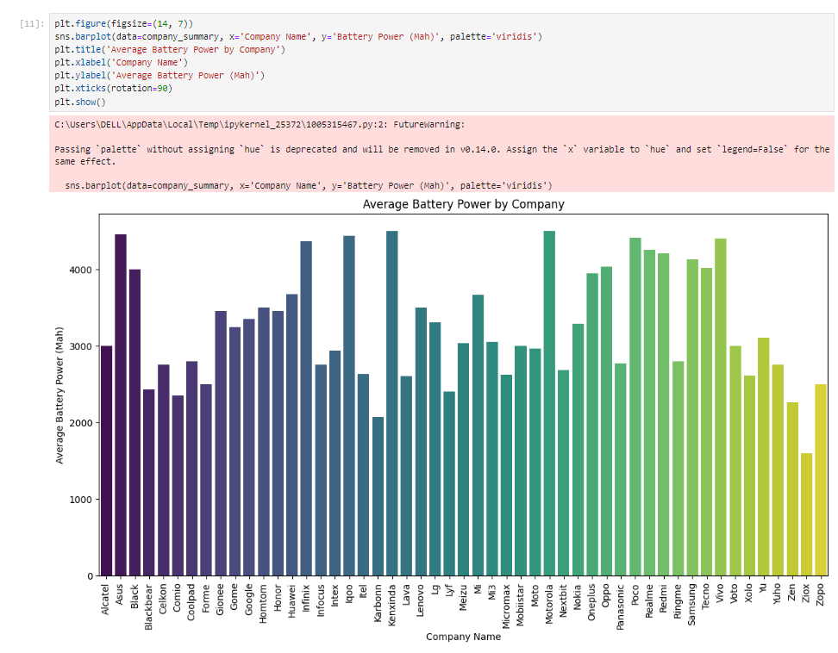
Average Battery Power Company Wise
Smart Phone Companies like Asus, Motorola, Tecno, Samsung, Panasonic, Vivo, Huawei, Kenxinda, Iqoo, Poco, Realme, and Redmi offer high battery power across all devices.

Slide 21
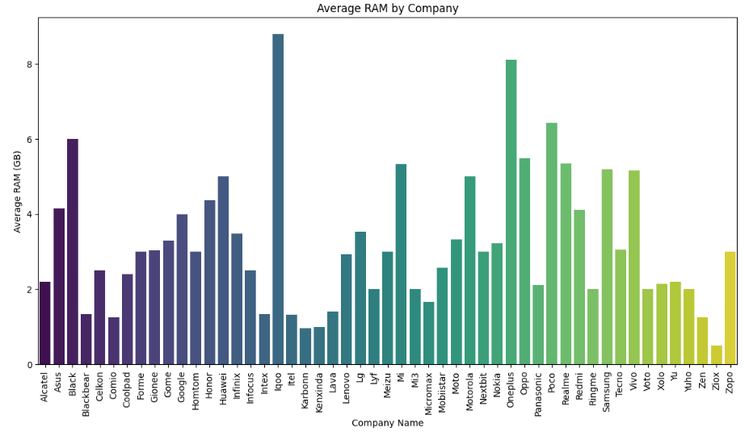
Average RAM by Company
Iqoo and Oneplus have offered comparatively higher RAM in smartphone devices catering to heavy multitasking and fast processors.

